Slide 1
Amazon vs. Walmart Swot Analysis
MKTG 6610-03
9/21/2023
By: Sri Vaishnavi Akkaraju

Slide 2


Summary of Both
Brands
Walmart
-First store opened in 1962 by Sam Walton
-More price focused (Everyday Low Price, Anytime, Anywhere)
-2.1 million employees Nationwide
-Many product lines from fresh produce and bakery items to electronics, furniture, and everyday essentials
-One of the largest distribution operations (9,000 tractors, 80,000 trailers and more than 11,000 drivers)
-Stores Internationally
-Newly started focusing on E-Commerce
Amazon
-Created in 1994 by Jeff Bezos
-Customer-focused (Based on convenience)
-About 1.5 million employees and about 1,300 distribution centers
-Initially started with the sale of books
-Internet-based, vast list of product lines including web services
-World’s largest online retailer

Slide 3
SWOT Analysis of Walmart
Strengths- | Weaknesses- | Opportunities- | Threats-
Large Brand Recognition | Labor Practices | International expansion
Strong Finances | Minimum E-commerce presence | Sustainability initiative | Online retail shift
Low-Cost Leadership | Negative public perception | Health and weakness market | Regulations
Key Locations | Dependence on China
Competition
E- commerce growth
Economic downturn
Notes:
ZS

Slide 4
SWOT Analysis of Amazon
Strengths- | Weaknesses- | Opportunities- | Threats-
Brand recognition | Dependence on third-parties | Physical stores | Controversy
Diverse products | Labor practices | Acquisitions | Competition
Distribution network | Retail presence | Backward integration | Regulations
Customer base | Data security concerns | Technological innovation | Recessions

Slide 5
Walmart’s vs. Amazon’s Strengths
Walmart:
Amazon:
Strengths-
Large Brand Recognition
Strong Finances
Low-Cost Leadership
Key Locations
Strengths-
Brand recognition
Diverse products
Distribution network
Customer base
Both Amazon and Walmart have unique strengths that have led to the success of their companies individually. In particular, each company has a strong brand recognition Worldwide. Yet Amazon is recognized internationally and has a loyal customer base derived from the satisfaction of their brand. Amazon also has a diverse range of products that they sell along with a large distribution network to effectively deliver these products. Walmart has effectively placed physical stores and takes pride in their focus on low-cost products. This brings in an abundance of loyal customers which allows them to flourish in the shopping industry with a strong financial performance in comparison other retail stores.

Slide 6
Walmart’s vs. Amazon’s Weaknesses
Amazon and Walmart have similar weaknesses. They both suffer from poor labor practices which can lead to a negative public perception, which we can see is one of Walmart’s weaknesses. Walmart is better in retail than e-commerce, while Amazon is better in e-commerce than retail. Walmart and Amazon can look to each other for ways to improve in e-commerce and retail, respectively. With Amazon’s online presence, there are concerns regarding their use of consumer data. They have a lot of information on their customers. Finally, both companies are dependent on others. Walmart is dependent on China while Amazon is dependent on third-parties.
Walmart:
Amazon:
Labor practices
Minimum E-commerce presence
Negative public perception
Dependence on China
Labor practices
Retail presence
Data security concerns
Dependence on third-parties

Slide 7
Walmart’s vs. Amazon’s Opportunities
Walmart is given the chance to grow internationally by utilizing its vast resources and experience to enter new markets across the world. Their sustainability activities, which are a growing global concern, can boost brand recognition and draw in environmentally sensitive customers. As the emphasis on wellbeing and healthy lifestyles grows, the health and wellness markets represent another potential growth sector. Walmart may also benefit from the growing e-commerce market by enhancing their online visibility and digital skills. On the other side, by increasing its investment in physical stores, Amazon has the chance to strengthen its retail footprint and close the gap between online and offline retail experiences. Backward integration into supply chains can streamline operations and increase efficiency, while strategic acquisitions can expand their customer base and service offerings. innovation in technology enables improvements in customer experience, delivery logistics, and AI-driven solutions to maintain a competitive edge in the shifting retail sector, and this represents a significant potential for Amazon.
Walmart:
Amazon:
International expansion
Sustainability initiative
Health and weakness market
E- commerce growth
Physical stores
Acquisitions
Backward integration
Technological innovation

Slide 8
Walmart’s vs. Amazon’s Threats
Walmart:
Amazon:
Walmart struggles to maintain its position as a leader in traditional retail in the face of fierce competition and the difficulty of moving towards internet sales. Concerns about regulatory compliance and economic changes never go away. Contrarily, Amazon faces issues and severe rivalry in the online retail sector, as well as strategic considerations for regulatory compliance and economic downturns. Both companies manage comparable issues despite having different business structures, highlighting the necessity of flexibility, regulatory adherence, and resilience in a dynamic retail environment.
Competition
Online retail shift
Regulations
Economic downturn
Controversy
Competition
Regulations
Recessions

Slide 9
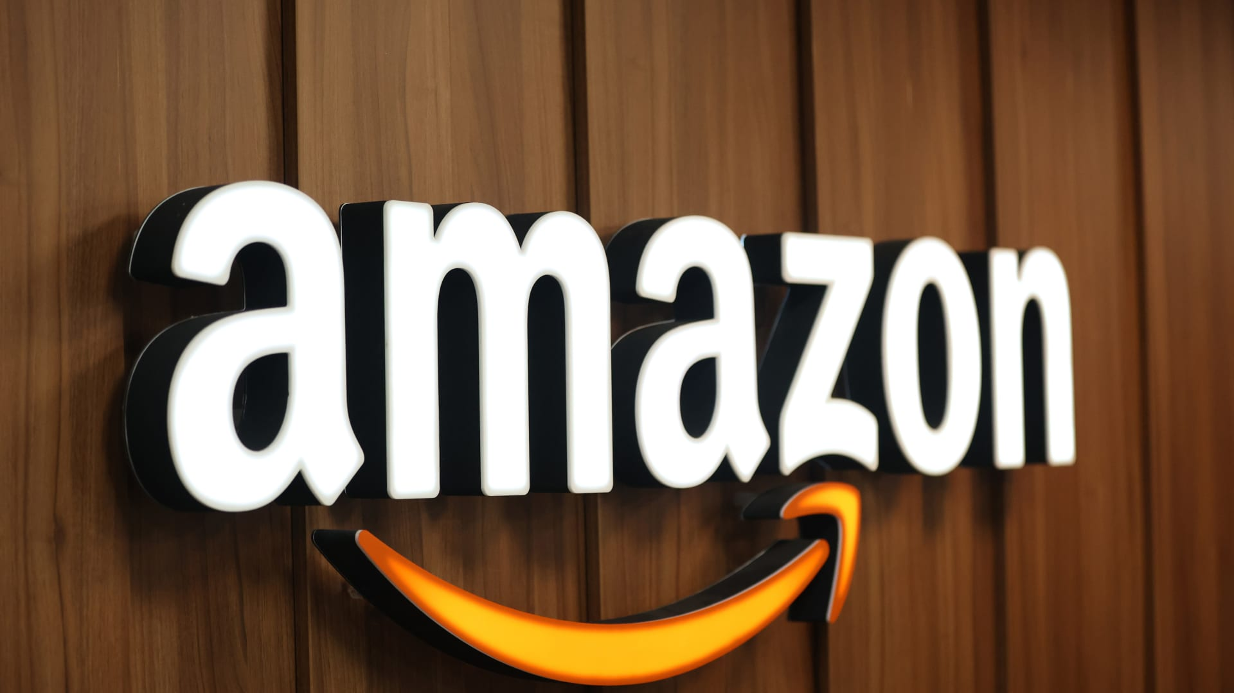
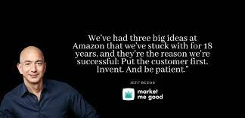
Conclusion: Which is a Stronger Brand?
Based on the research found, we believe Amazon is the stronger brand. Although a newer company, they have a strong brand recognition internationally. With their diverse product lines and expansive E-commerce operations, Amazon has become a highly acknowledged company. Along with their adaptability to technology and the modern world, they have endless opportunities to expand. If their expansion results in physical stores, they will succeed Walmart in multiple ways. In the book “Winner Sells All”, author Jason Del Rey states “If Amazon wasn’t innovating in physical retail, especially in a retail sector as important to consumers as grocery, was the tech giant really living up to its promise to be the world's most customer-centric company?” (Del Rey, 2023, p. 132). Being customer-focused, Amazon has the strongest potential to use their strengths to their advantage and dominate the shopping industry.

Slide 10
References:
About Walmart. (n.d.). https://corporate.walmart.com/about#:~:text=Walmart%20began%20building%20Supercenters%20in,apparel%2C%20toys%20and%20home%20furnishings.
Encyclopædia Britannica, inc. (2023, September 20). Amazon.com. Encyclopædia Britannica. https://www.britannica.com/topic/Amazoncom
Rey, D. J. (2023). Winner sells all: Amazon, Walmart, and the battle for our wallets. Harper Business, an imprint of HarperCollinsPublishers.

